Slide 1

Email Archiving
Where did I put that mail?

Slide 2
A better approach of e-mails : WHY ?
Business criticity
Importance to manage :
  Authenticity
  Integrity
  Perennity
  Compliance
High TCO of mail servers

Slide 3

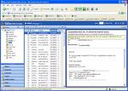









The e-mail in real life

Slide 4

Worst practices
Spend 25 % of my time to receive, send and manage my e-mails
Generate 30 to 40 Mbytes of data (receiving and sending private, personal and corporate information)
Use my e-mail container as THE online and offline access to my documents
File alsmost all information on local and personal medias
Deviate from corporate archiving and security policies
Prevent from sharing my documents with my colleagues

Slide 5

Stakes
Reduce server storage space
Facilitate quotas management
Eliminate non archive files (‘PST’ , local databases)
Legal aspects
Compliance aspects
Integration with other filings
Integration with processes

Slide 6
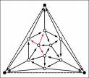
Problems to address
Differentiate private, personal and corporate e-mails
Oversized and saturated mailboxes
Proprietary (archiving and compression)
Volume
Duplicates
Mail servers management TCO
Categorization (levels : individual – group - department - enterprise)
Integration with the other electronic documents
Retention period management

Slide 7
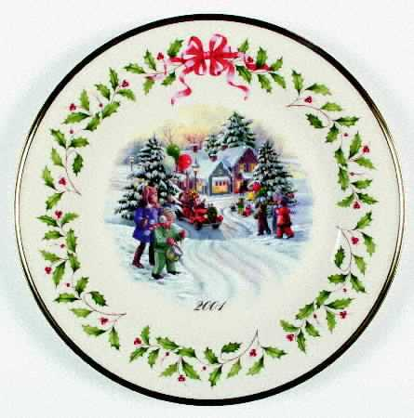


The Two Faces of Archiving
Space Management:
Move old, inactive files to less expensive storage, resulting in reduced backup windows and reduced storage costs.
Data Retention:
Protect your data for the long term with non-erasable, non-rewriteable (NENR) storage solutions and demonstrate compliance to regulations.
Consider This: “If it is worth saving, it is worth protecting”

Slide 8
Email archiving
Notes:
8

Slide 9
Overview
Outlook client integration
Outlook web access
Administration view

Slide 10
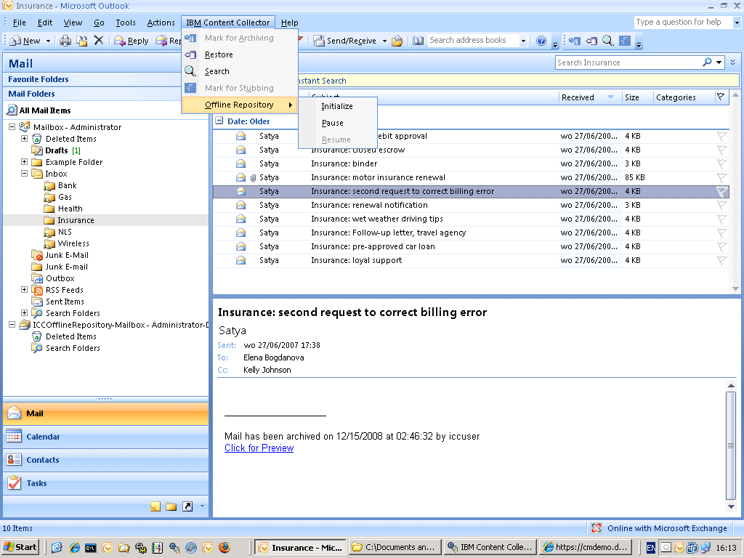
Straightforward integration in Outlook

Slide 11
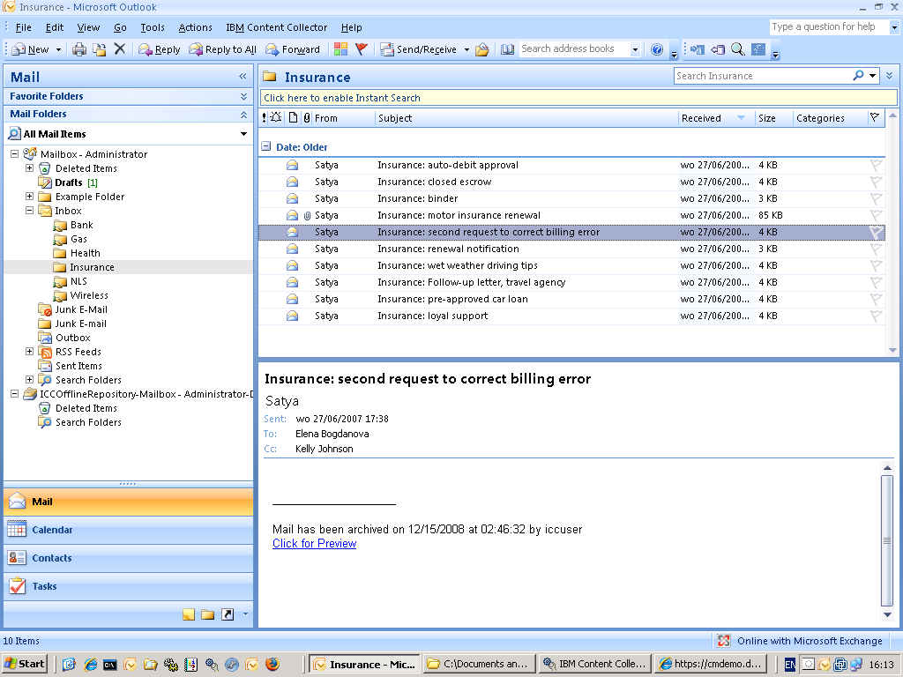
Non archived mail
Archived mails
The body and attachments are archived and can be previewed through simple click

Slide 12
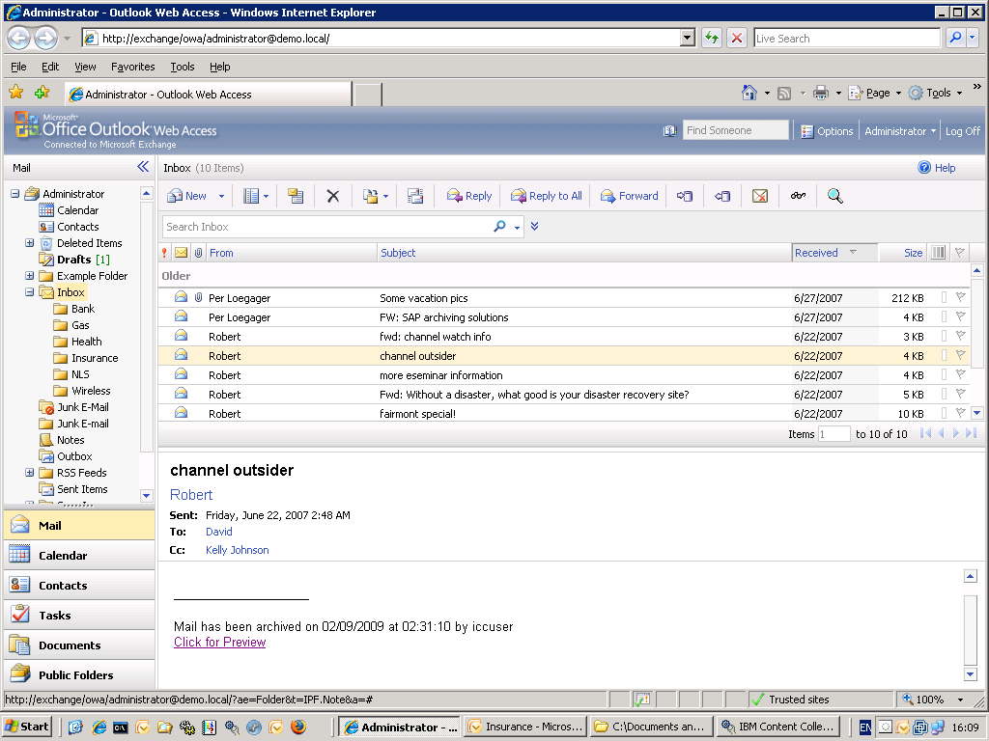
Added menu items
Non archived mails and archived mails in the same list
The stubbed mail can be accessed easily through one click

Slide 13
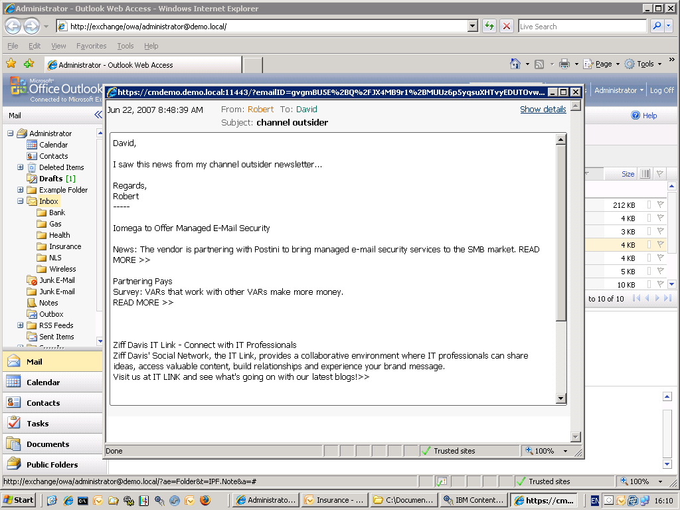
OWA preview screen of a mail: access to the body of the mail and possible links to attachments

Slide 14
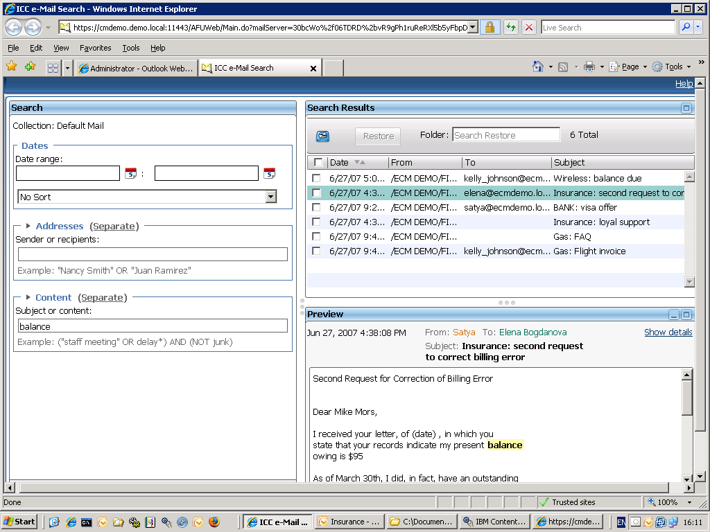
Search result with option to mass restore
Searched word in contents of the archive
Mail preview screen
Search words are highlighted

Slide 15
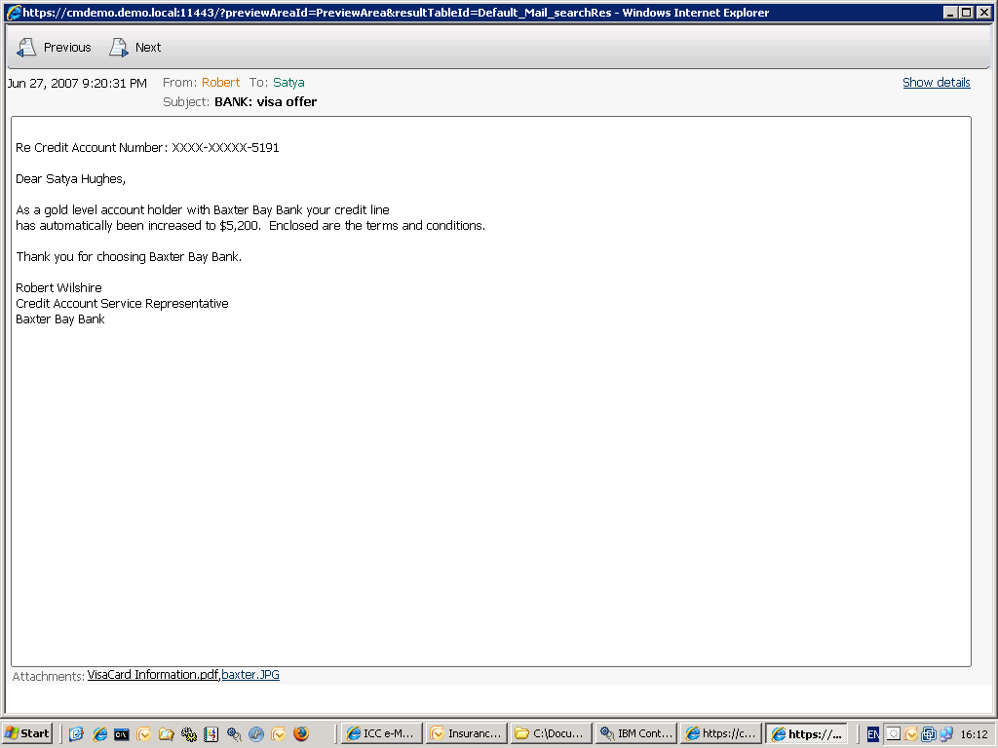
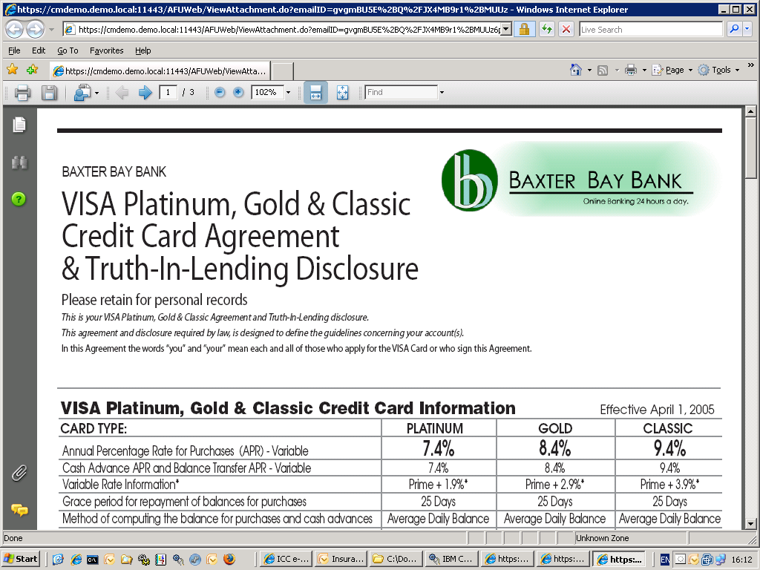
Many file formats are supported in the full text search engine
Search results also include attachment hits

Slide 16
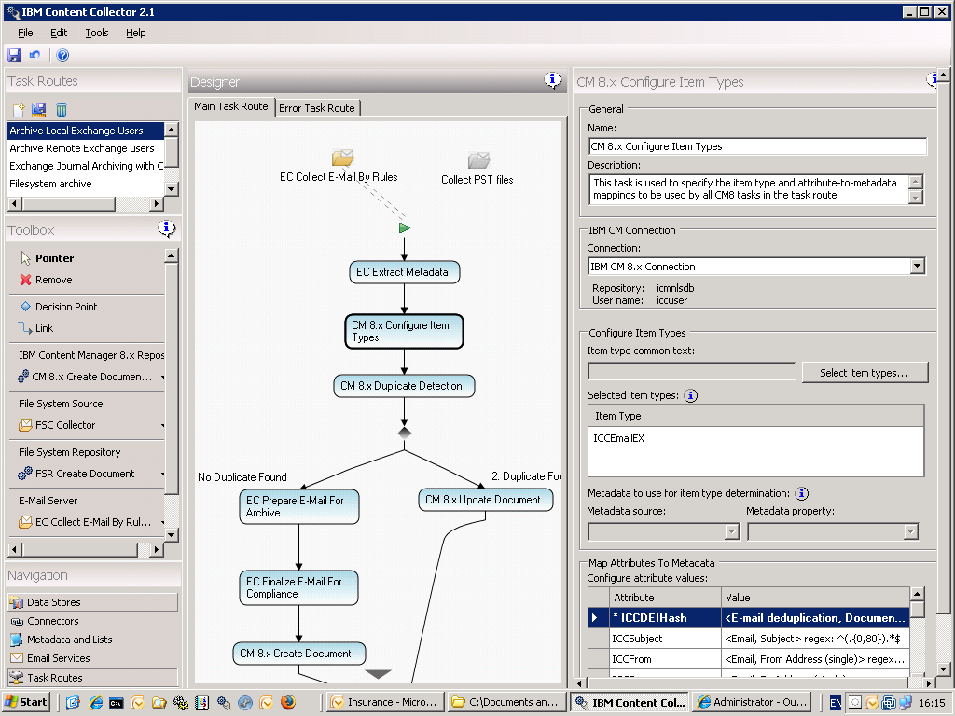
Out of the box routes
Easy administration interface
Tasks configuration parameters
Drag and drop tasks

Slide 17
Email archiving
Notes:
17

Slide 18
2 major roles of Storage in data retention management (archiving)
Improve Return On Investment/TCO:
By archiving to less expensive storage (disk/tape tiering)
Improve Compliance:
By archiving sensitive information to Secure Storage: Non-Erasable, Non-Rewritable (NENR disk or WORM media).
Notes:
Data must be kept, because it represents a company asset
CAD/CAM designs, insurance claim processing, presentations, Web content, user manuals, training material, digitized information such as check images, medical images, videos, historical documents, photographs, ….
Data must be kept to comply with industry regulations or laws (compliance or regulated data)
Sarbanes Oxley Act, the USA Patriot Act, HIPAA, the European Union Data Protection Directive, Securities Exchange Commission (SEC) Rule 17a-4, and many more.
Can include e-mail, instant messages, business transactions, accounting records, contracts, or insurance claims processing

Slide 19
Retention-managed data
Data that will not change
(aka reference data, archive data, fixed content, unstructured data)
Typically kept in an archive or repository
Variable retention periods (usually long, but can vary from a few months to forever)
Access pattern
  write once, read rarely - or never
  usually most frequently accessed near its creation
Not alterable, not erasable (WORM)
Long term readable (usable) – data rendering
Needs to be deleted after retention period
(could create a liability if not deleted)
Notes:
When considering the safekeeping of retention-managed data, companies also need to consider storage and data characteristics that differentiate it from transactional data.
Storage characteristics of retention-managed data include:
Variable data retention periods: Usually a minimum of a few months, up to forever.
Variable data volume: Many customers are starting with 5 to 10 TB of storage for this kind of application (archive) in an enterprise. It also usually consists of a large number of small files.
Data access frequency: Write once read rarely or read never. See data life cycle in the following list.
Data read/write performance: Write handles volume; read varies by industry and application.
Data protection: Pervasive requirements for non-erasability, non-rewritability, and destructive erase (data shredding) when the retention policy expires.
Data characteristics of retention-managed data include:
Data life cycle: Usage after capture, 30 to 90 days, and then near zero. Some industries have peaks that require access, such as check images in the tax season.
Data rendering after long-term storage: Ability to view or use data stored in a very old data format (say after 20 years).
Data mining: With all this data being saved, we think there is intrinsic value in the content of the archive that could be exploited.

Slide 20
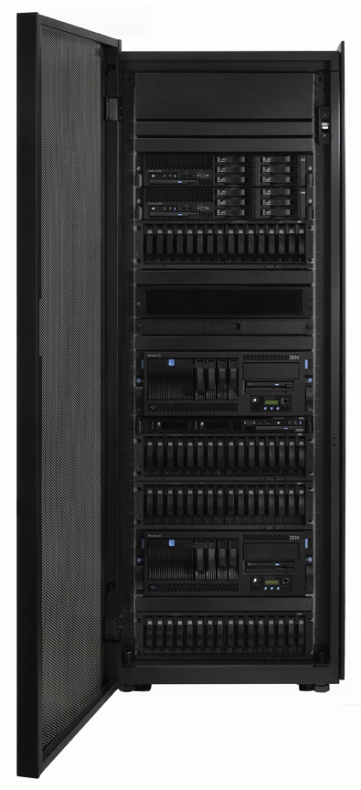
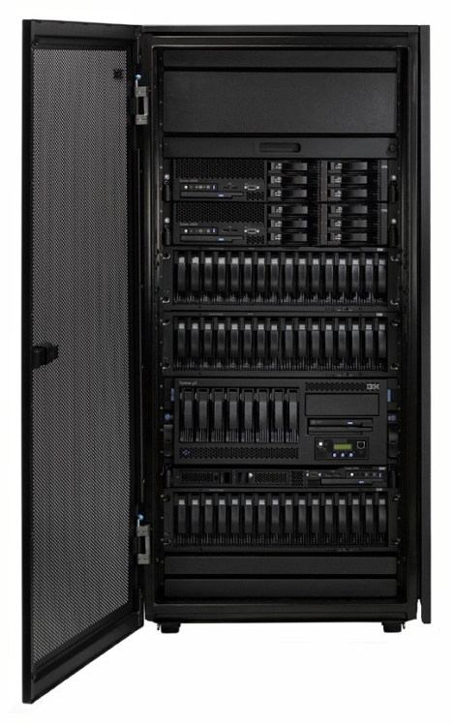
IBM DR550: Solution view
IBM’s long-term data retention and archiving offering:
  Provides non-rewritable, non-erasable policy based storage management
  Automatic, policy based data migration
A solution made up of IBM hardware and IBM software products
Redundant components, High Availability, pre-mounted
  Attaches to customer’s IP Network
Software pre-installed and to a large extent pre-configured
Disk pre-installed and Tape-ready configurations

Slide 21

Results
Managed archive :
  Reduces storage requirements on mail servers
  Manages uniqueness
  Enforces and automate adjustable retention policies
  Centralizes and facilitates administration
  Avoids existence of multiple local or centralized ‘PST’ files
  Federates context to everyone authorized
Compliance and legal archiving :
  Adheres to ever increasing regulations
  Centralizes access security
  Prevents unauthorized deletions of critical data
  Protects integrity of private records
  Purges expired information
  Migrates to suitable preservation formats

Slide 22

Thank you for your attention!

